Slide 1


Case study # 4 Data Bank
Done By Thivya
On 21-July-2022

Slide 2
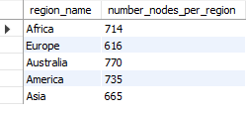
A. Customer Nodes Exploration
1. How many unique nodes are there on the Data Bank system?
select count(distinct node_id) from customer_nodes ; 5 unique nodes
2.What is the number of nodes per region?
select r.region_name,
count(node_id) as number_nodes_per_region
from customer_nodes c
join regions r
on c.region_id=r.region_id
group by 1 ;

Slide 3
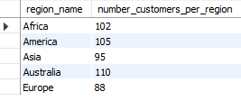
3. How many customers are allocated to each region?
select r.region_name,
count(distinct customer_id) as number_customers_per_region
from customer_nodes c
left join regions r
on c.region_id=r.region_id
group by 1 ;

Slide 4

4. How many days on average are customers reallocated to a different node?
select round(avg(date_difference),0) as avg_diff
from (select customer_id,node_id,(end_date-start_date) as date_difference
from customer_nodes
where end_date!='9999-12-31‘
Group by 1,2) A;

Slide 5
5. What is the median, 80th and 95th percentile for this same reallocation days metric for each region?

Slide 6

B. Customer Transactions
6. What is the unique count and total amount for each transaction type?
select txn_type,sum(txn_amount),count(txn_type) as transaction_types
from data_bank.customer_transactions
group by txn_type

Slide 7

7. What is the average total historical deposit counts and amounts for all customers?
select round(avg(transaction_amount),0) as avg_transaction_amount,
round(avg(transaction_types),0) as avg_transaction_types
from(select n.customer_id,txn_type,
avg(txn_amount)as transaction_amount,
count(txn_type) as transaction_types from data_bank.customer_transactions t
left join data_bank.customer_nodes n
on t.customer_id=n.customer_id
where txn_type='deposit'
group by 1,2) A

Slide 8
8. For each month - how many Data Bank customers make more than 1 deposit and either 1 purchase or 1 withdrawal in a single month?

